Slide 1
Hillcrest Avenue
Pre-Filing Community Meeting
Preliminary Plan of Subdivision Application
May 11, 2022

Slide 2
Introduction
Current Use: Vacant Single-family home, formerly a business use.
Proposed Use: Two-floor medical office building, 10,200 sf with surface parking.
Public open space to be provided via donation of adjacent land to Parks Department

Slide 3
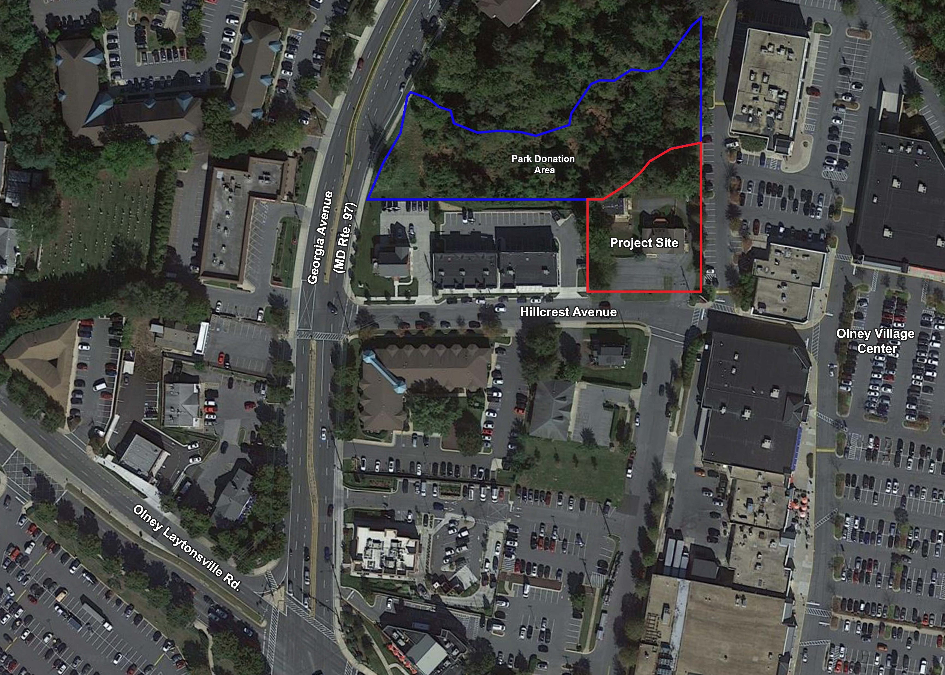
Context Map

Slide 4
Existing Conditions
Existing house was used for a daycare, which closed
Driveway access to Hillcrest Avenue
There is no existing forest onsite, just some individual trees
Adjacent property to the west – developed as office/commercial with a parking lot and on street parking
Adjacent property to east – Olney Village Mart shopping center – back of buildings and parking lot
Adjacent property to the north – stream valley, partially forested, and invasive species present

Slide 5
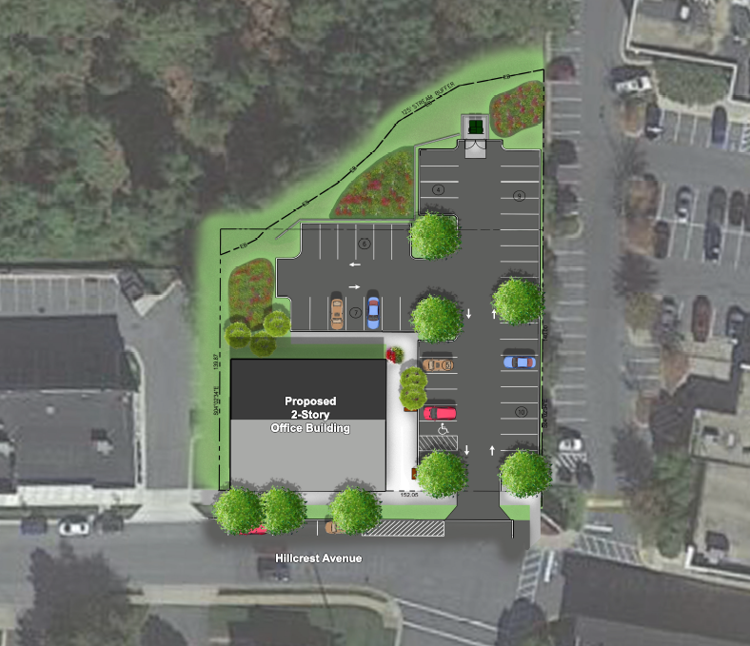
Preliminary Plan
For Illustrative purposes only. Drawing is not to scale.

Slide 6
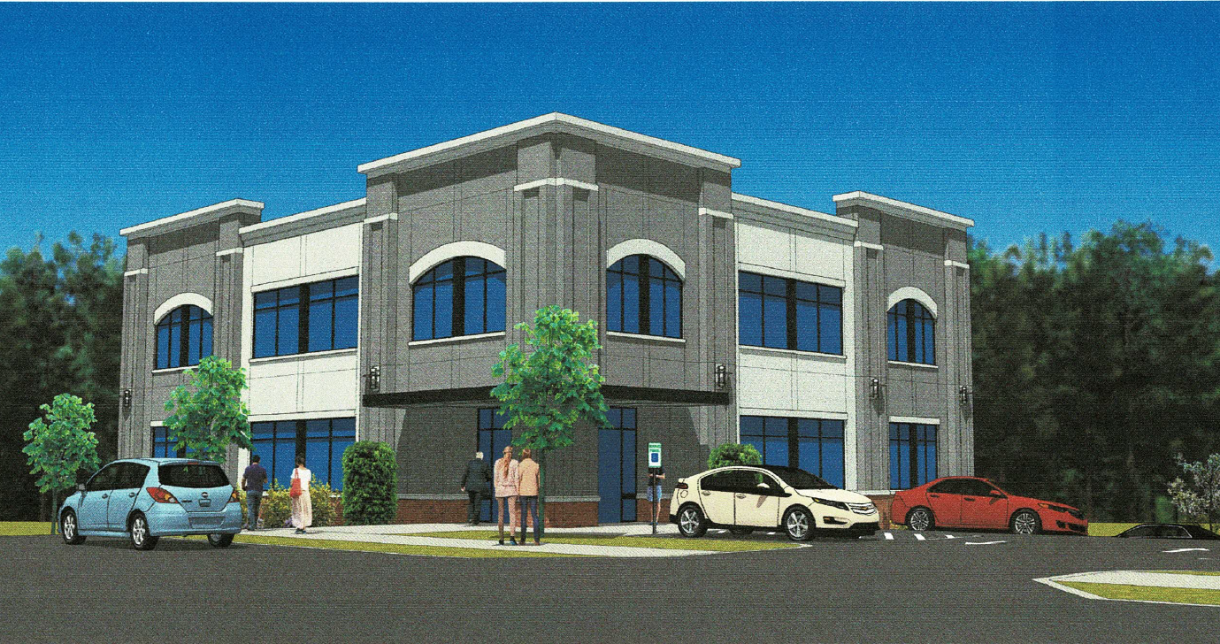
Architecture
Note: Images shown are conceptual. Materials and design details are subject to change.

Slide 7
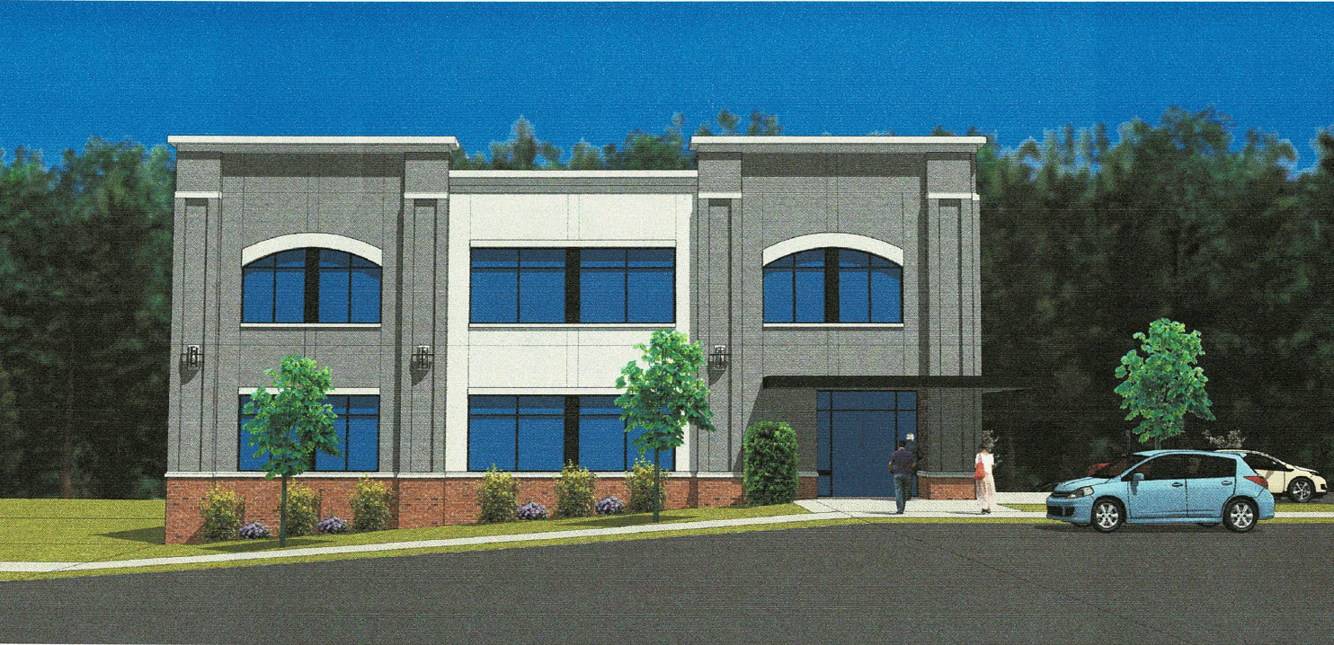
Architecture
Note: Images shown are conceptual. Materials and design details are subject to change.

Slide 8
Milestones
Pre-Filing Community Meeting………………………………………………………………. May 11, 2022
Application Filed……………………………………………………………………………………..Spring 2022
Development Review Committee Meeting……………………………………………..Spring 2022
Planning Board Hearing………………………………………………………………………….. Fall 2022
Construction Starts…………………………………………………………………………………. Summer/Fall 2023

